Slide 1
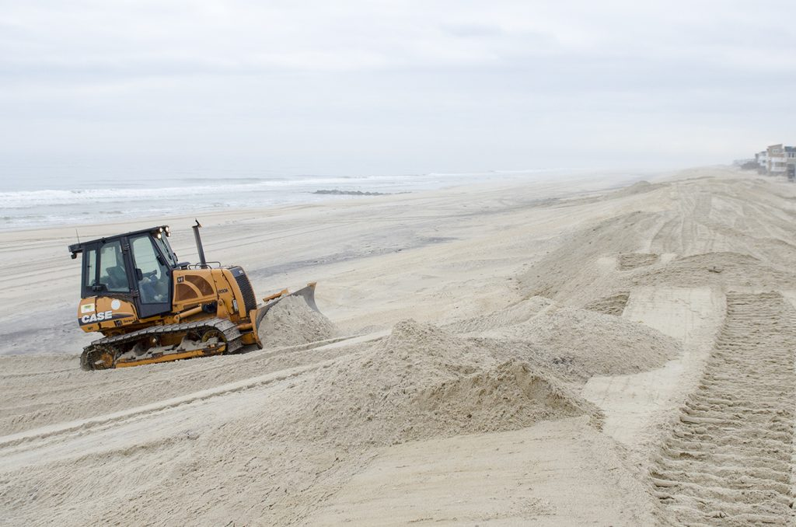
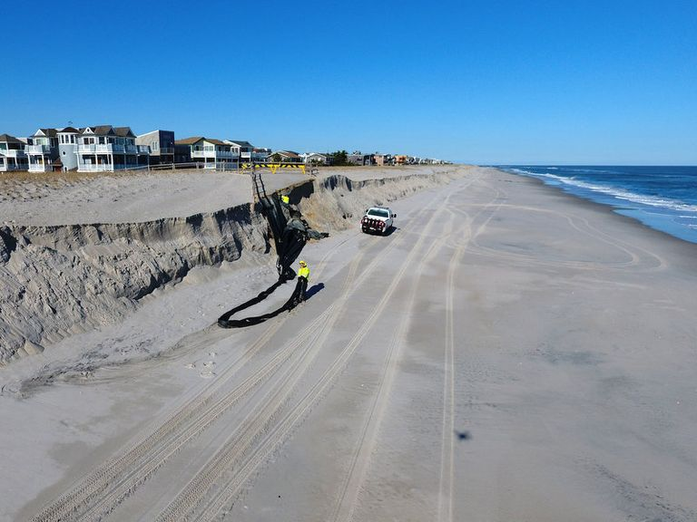

Winter Storms and Beach Erosion in Harvey Cedars, NJ
Effects
By Clare Donnelly
clare.donnelly@student.shu.edu
Seton Hall University
Coastal flooding from a Winter Storm on March 14, 2017, in HC removed over 20 yards of sand
Sand is extracted from the ocean or artificially placed on top of shoreline for protection-Disrupts the food chain, including seagulls eating
exposed organisms
Lack of natural vegetation in sculpted dunes effects
  Promotes loss of sediments
  Buries root systems
  Beach grass is affected
  Sea oats are affected
Causes
”Coastal erosion is the process by which local sea levels rise, strong wave energy, and coastal flooding wear down or carry away rocks, soils, and or sands along the coast.
The main objective is to preserve the of the shoreline environment using beach replenishment, while consulting wit Insurance Adjustor s to reduce claims.
Harvey Cedars has been affected by winter storms called Nor’easters eroding sand and damaging existing seawalls, which allowing ocean water to flood towns and businesses. Harvey Cedars’ area is 1.189 mi² and its elevation is 3’ above sea level.
The negative effects of beach erosion due to storms have been caused by offshore storms that result in extreme flooding because of, “wind driven waves and higher tides than normal,” (NJ.com) moved the shoreline 13 feet landward n Harvey Cedars
Long Term Solutions
Relocation to “A” or “AE” flood zone
Require new construction to be elevated on piles with flood vents
Allow claims up to $90,000 in claims from FEMA
Short Term Solutions
Soft Method-Beach Nourishment through Sand Replenishment,
Sand replenished during winter = fewer birds and organism effected by transition
Plow sand in long low angled sloping dunes to reduce wave energy
Plant native plants immediately to stabilize sediments and reduce density or compaction
Eric Englund | on January 30, 2. (n.d.). Army Corps to Restore Harvey Cedars&nbsp;Beaches Eroded from Sandy: The SandPaper. Retrieved December 08, 2020, from https://www.thesandpaper.net/articles/army-corps-to-restore-harvey-cedars-beaches-eroded-from-sandy/
MaryAnn Spoto | NJ Advance Media for NJ.com. (2017, January 26). See aerial views of beaches battered by nor'easter. Retrieved December 08, 2020, from https://www.nj.com/news/2017/01/watch_aerial_view_of_beach_erosion_in_nj_towns_bat.html

Slide 2
Works Used
Lutgens, Frederick K., Tarbuck, Edward J. (2016). Essentials of Geology, 13e. Hoboken, NJ: Pearson.
The Preventive Methods of Beach Erosion. (n.d.). Retrieved December 8, 2020, from https://cstem.uncc.edu/sites/cstem.uncc.edu/files/media/SV/2010/QMRM/Helen%20Robertson-%20The%20Preventive%20Methods%20of%20Beach%20Erosion.pdf
U.S. Climate Resilience Toolkit. (n.d.). Retrieved November 10, 2020, from https://toolkit.climate.gov/topics/coastal-flood-risk/coastal-erosion
(n.d.). Retrieved November 10, 2020, from https://explorebeaches.msi.ucsb.edu/beach-health/beach-nourishment
Home | FEMA.gov. (n.d.). Retrieved December 8, 2020, from https://www.fema.gov/media-library-data/1574864015193-1aaca0b6064143f26be8218a1c90e576/Protect_Your_Home_Flooding_508.pdf
Climate Change and Extreme Snow in the U.S. (n.d.). Retrieved December 08, 2020, from https://www.ncdc.noaa.gov/news/climate-change-and-extreme-snow-us
Eric Englund | on January 30, 2. (n.d.). Army Corps to Restore Harvey Cedars&nbsp;Beaches Eroded from Sandy: The SandPaper. Retrieved December 08, 2020, from https://www.thesandpaper.net/articles/army-corps-to-restore-harvey-cedars-beaches-eroded-from-sandy/
MaryAnn Spoto | NJ Advance Media for NJ.com. (2017, January 26). See aerial views of beaches battered by nor'easter. Retrieved December 08, 2020, from https://www.nj.com/news/2017/01/watch_aerial_view_of_beach_erosion_in_nj_towns_bat.html
New Jersey Beach Profile Network: #143 -73rd Street, Harvey Cedars, Ocean County. (2017). Retrieved from https://stockton.edu/coastal-research-center/njbpn/reports.html

