Slide 1

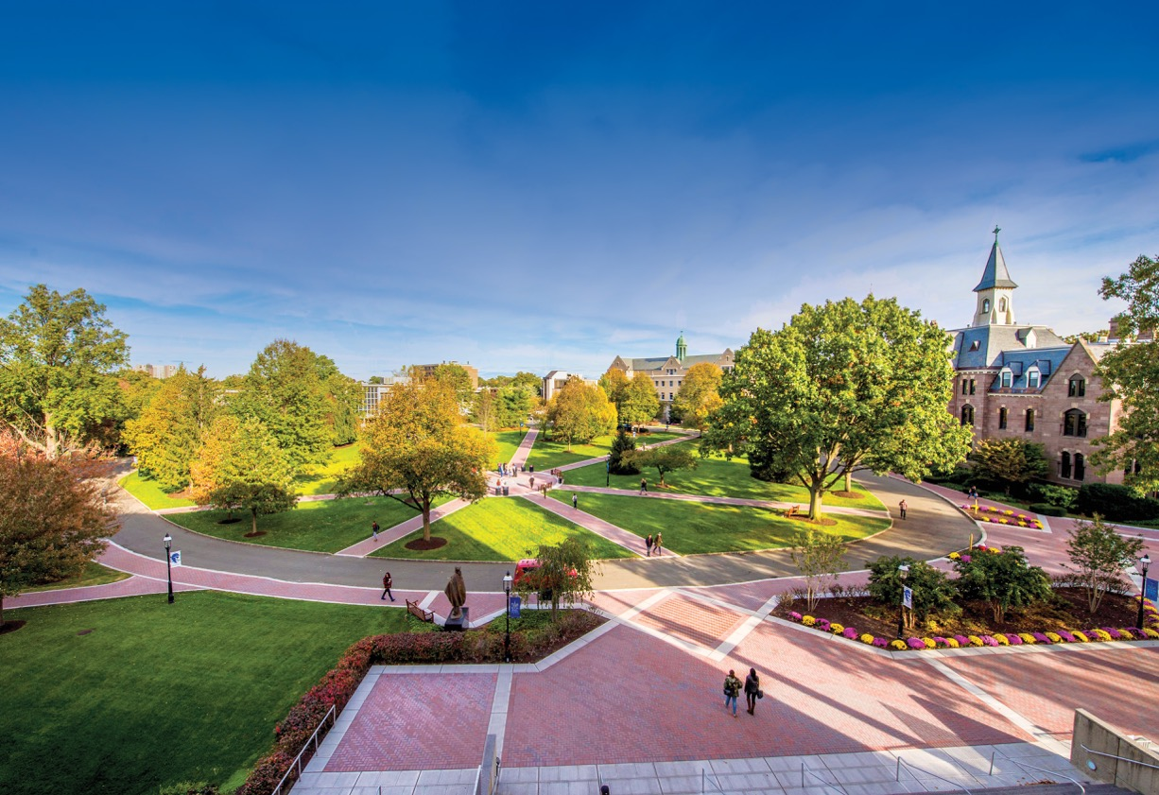

Slide 2
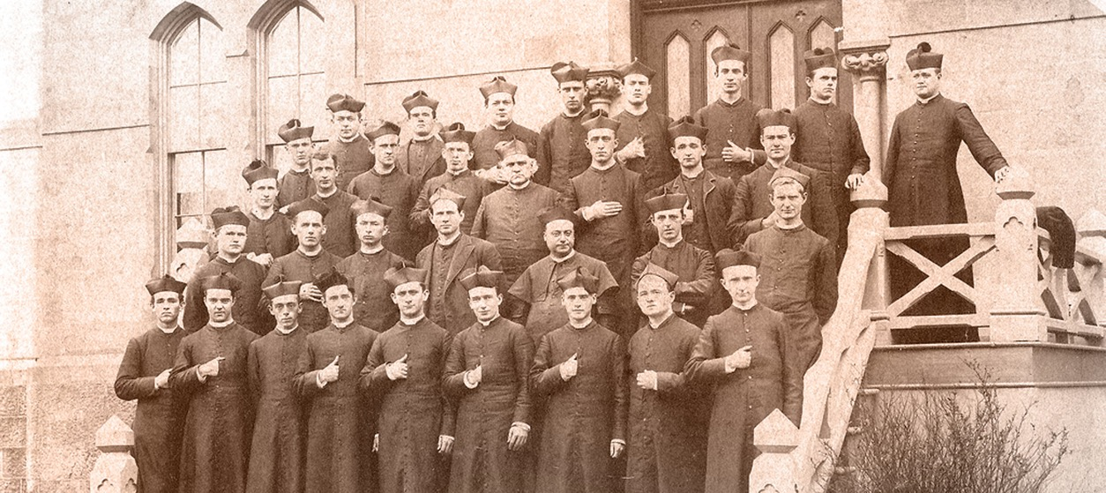
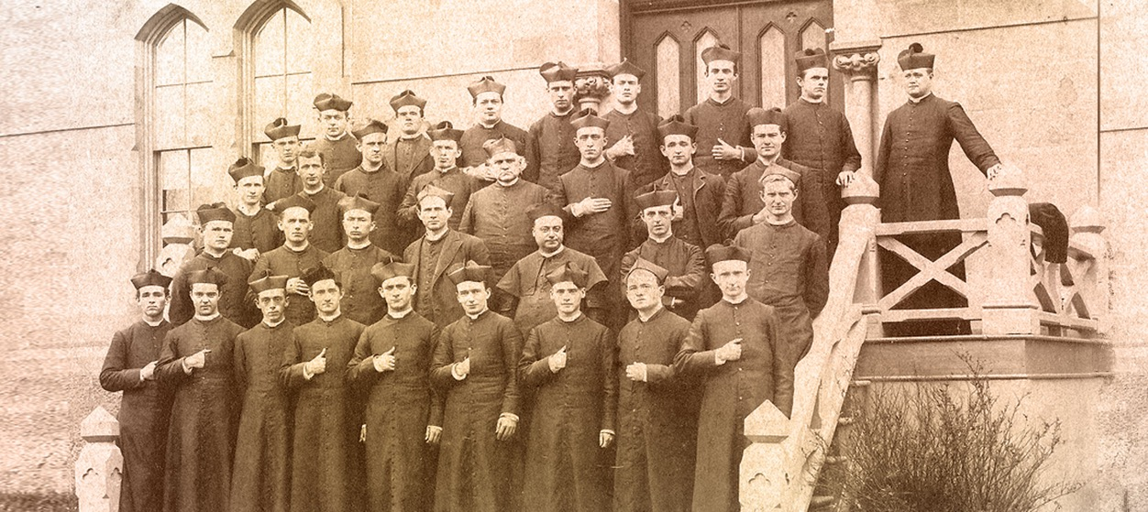
One of the country’s leading Catholic universities, Seton Hall has been developing students in mind, heart and spirit since 1856.

Slide 3

Today, Seton Hall is defining what it means to be a great mind by educating compassionate and informed critical thinkers who will make a difference.
(photo of students in lab wearing googles)

Slide 4
The University offers more than 90 undergraduate programs and more than 120 graduate programs through its nine schools and colleges:
  Arts & Sciences
  Business
  Communication & The Arts
  Diplomacy & International Relations
  Education & Human Services

Slide 5
The University offers more than 90 undergraduate programs and more than 120 graduate programs through its nine schools and colleges:
  Health & Medical Sciences
  Law
  Nursing
  Theology

Slide 6
During the past decade, Seton Hall students, faculty and alumni have received numerous prestigious academic awards , including:
  Fulbright Awards
  Guggenheim Fellows
  Pickering Fellowships
  Boren Awards
  Truman Award

Slide 7
Seton Hall’s academic excellence has been singled
out for national distinction by leading organizations.
  Top-Tier National University – U.S. News & World Report
  One of the Best Colleges in the Nation – The Princeton Review
  #1 Business Leadership Program - HR.com
  Top 5 Colleges for Internships – International Business Times
  Top 10 Health Law Program – U.S. News & World Report

Slide 8
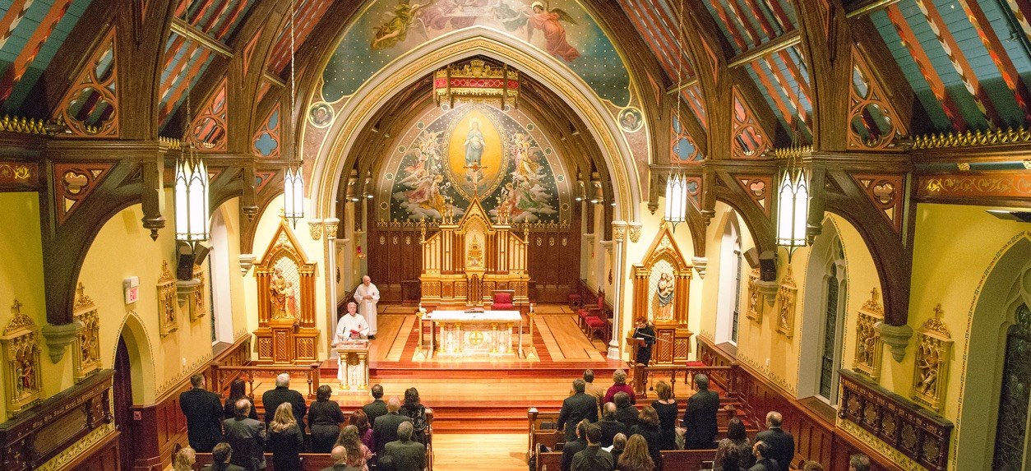
Our welcoming community, built on Catholic values, offers students a supportive and academically challenging home.

Slide 9
Seton Hall’s value and affordability also has been singled out for national distinction by leading organizations.
  One of America’s Best Value Colleges – Forbes
  Best Colleges in the Nation for Your Money – Money
  Top 25 Colleges for Grads Who Get the Highest-Paying Jobs – Buzz Feed
  Top 25 Private Colleges with the Highest Student Mobility Rates – Chronicle of Higher Education

Slide 10
In recent years, Seton Hall experienced a significant increase in total student enrollment.
Undergraduate Enrollment: 6,000+
Graduate Enrollment: 4,300+
Total Enrollment: 10,300+
*2018 Data

Slide 11
Seton Hall is proud of its diverse student body, which represents nearly all 50 states and more than 50 nations.
  45%* 35%*
Students of Color Non-Catholic Students
* Undergraduate student body

Slide 12

A founding member of the BIG EAST Conference, the Seton Hall Pirates field 14 NCAA Division I varsity sports teams.

Slide 13

Located close to New York City, Seton Hall’s three campuses offer its students a wealth of internship, job and cultural opportunities.

Slide 14
Seton Hall Campuses:
Main Campus
    South Orange, New Jersey
Law Campus
    Newark, New Jersey
Interprofessional Health Sciences Campus
    Clifton/Nutley, New Jersey

Slide 15

In recent years, the University invested more than $150 million in new campus buildings and renovations.

Slide 16

Recently completed campus projects include:
Interprofessional Health Sciences Campus

Slide 17
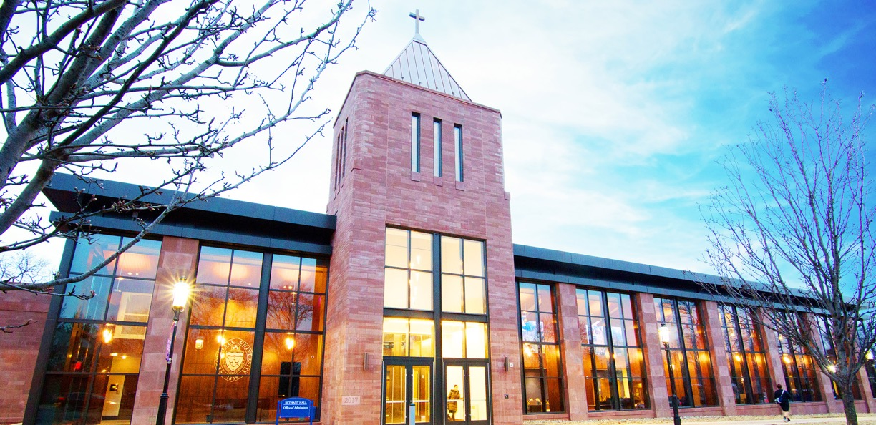
Recently completed campus projects include:
Bethany Hall

Slide 18
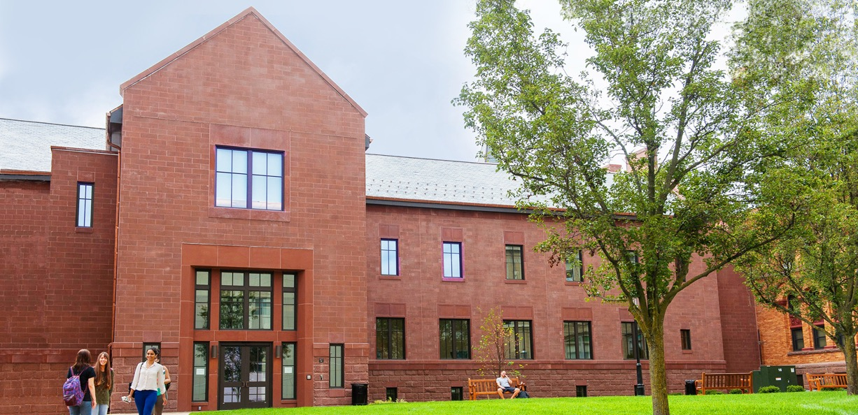
Recently completed campus projects include:
Stafford Hall

Slide 19
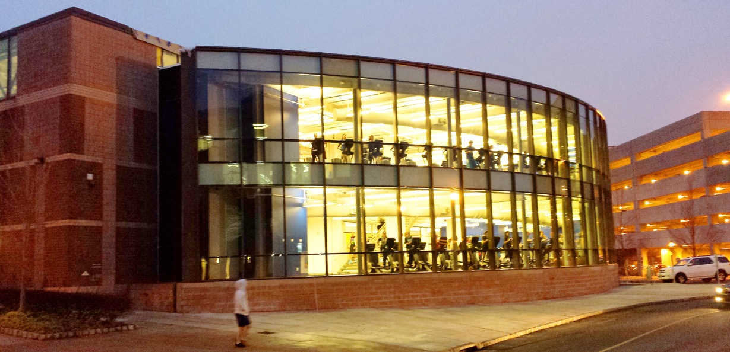
Recently completed campus projects include:
Walsh Recreation Center

Slide 20
Seton Hall is a national leader in job preparation and placement, which provides our graduates with a distinct career advantage:
17,000 80+% 93 %
Internship Students Job Placement Rate
Opportunities who complete for Graduates
Internships

Slide 21
Our students intern and get hired at some of the nation’s leading corporations and organizations:
Goldman Sachs • CNN • Google • Sony Music
Johnson & Johnson • United Nations • KMPG
MTV • Lockheed Martin • The Wall Street Journal U.S. Attorney’s Office • Lincoln Center • FBI
JP Morgan Chase • State Department • Pfizer

Slide 22

One of Seton Hall’s greatest strengths comes from our close connections with our more than 100,000 alumni around the globe.

Slide 23

Great academics. Great experiences. Great opportunities. These are the hallmarks of a Seton Hall education.

