Slide 1


Promoting Good Wealth: CST and the link between Wealth, Well-Being and
Poverty Alleviation
Charles M. A. Clark
Senior Fellow,
Vincentian Center for Church and Society
Professor of Economics,
St. John’s University
Capital Markets Colloquium,
Seton Hall University,
February 26, 2014

Slide 2
Wealth and Poverty
Poverty is often seen as the absence of wealth
Wealth creation is therefore seen as essential for poverty alleviation.
Economists for 400 years have promoted “good wealth.”
Paradox: wealth creation does not always reduce poverty.
“Once profit becomes the exclusive goal, if it is produced by improper means and without the common good as its ultimate end, it risks destroying wealth and creating poverty” (CV 29). Benedict XVI

Slide 3
Overview
1. Good and Bad Wealth
2. Views of Wealth in Catholic social thought
3. Real wealth creation and poverty alleviation

Slide 4
What is wealth?
“Wealth is a term overflowing with contradictions. On the one hand, wealth holds out the promise of abundance, while on the other hand its creation is often tied to a reality of scarcity.
Furthermore, on the one hand wealth is linked to happiness and well-being, and on the other hand it, after a certain level, it bears very little correlation to either happiness or well-being.
Lastly, on the one hand, it can provide the individual with security against the uncertainties of the future and thus a certain amount of independence, yet on the other hand, wealth can be the cause of individual insecurity and dependence for those without wealth. Such contradictions seem to call out for Harry Truman’s proverbial one-handed economist”

Slide 5
What is Wealth?
Wealth is a social category.
“The ideas of the ruling class are in every epoch the ruling ideas…. The ruling ideas are nothing more than the ideal expression of the dominant material relationships.” (The German Ideology, Marx)
Stone Age Flints
Herders Cattle
Middle Ages Land
Mercantilism Gold, Silver and Slaves
Industrial Revolution Plant & Equipment
Money Manager Capitalism Financial Assets

Slide 6
Where does wealth come from?
All wealth comes from God’s gift of creation and humanities accumulated store of technical knowledge
The productive value of any asset always flows from its social origins and its social usage and never to the inherent productivity of the asset itself, or of the productivity attributed to the owner of the asset (Veblen 1908).
Myth of Wealth Creators

Slide 7
Wealth: Individual and Social
Assets that yield an income?
Assets that allow for future production?
Characteristics:
  Scarcity
  Private
  Exclusion
  Value based on scarcity
Characteristics:
  Abundance
  Social
  Cooperation
  Value based on productivity

Slide 8
How can Wealth be Bad?
Distinction between wealth creation that increases well-being and wealth capture, gain at another's expense.
Modes of Wealth Capture:
  Social Creation of Scarcity:
    “Wealth is not wealth because of its substantial qualities. It is wealth because it is scarce” (L. Robbins).
  Social Exclusion:
  Shifting of Costs:

Slide 9
Example of Bad Wealth: Larry Summers World Bank Memo
Summers suggested that high polluting industries be moved from rich to poor countries:
1. Poor countries have less pollution, due to there lower level of past economic development. They are thus, according to Summers, “under-polluted.” It would be efficient to transport pollution created in rich countries to poor countries.
2. Since many of the effects of pollution often happen later in life, and since the life expectancy is lower in poor countries, the negative effects of the pollution will be lower in poor countries.
3. Since the costs of the negative effects of the pollution are measured in terms of “foregone earnings from increased morbidity and mortality,” the costs are lower in poor countries (since their earnings are lower) than it would be in wealthy countries. Summer states: “I think the economic logic behind dumping a load of toxic waste in the lowest wage country is impeccable and we should face up to that.”

Slide 10
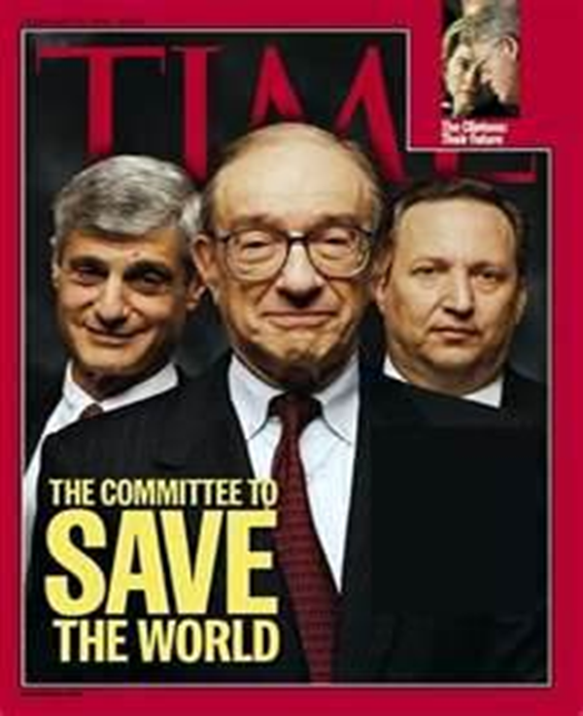
Summers concludes:
“The problem with the arguments against all of these proposals for more pollution in LDCs (intrinsic rights to certain goods, moral reasons, social concerns, lack of adequate markets, etc.) could be turned around and used more or less effectively against every Bank proposal for liberalization.”

Slide 11
Catholic social thought and Good Wealth
What CST is:
  Moral theology applied to economic, social and political issues.
  Universal principles based on Revelation and Reason necessary for a just economy.
What CST is not:
  Alternative Economic Theory, Model or Policy.
    There is no Catholic fiscal or monetary policy.
  The “Third Way” between Capitalism and Socialism

Slide 12
Early CST: The Way (1st-2nd Century)
“The Way of Life is this: first, love the God who made you; secondly, your neighbor as yourself: do not do to another what you do not wish to be done to yourself.”
“The Way of Death is this: … thefts, idolatries, magical arts, sorceries, robberies, false testimonies, hypocrisy, duplicity, fraud, pride, malice, covetousness, … Of men that have no heart for the poor, are not concerned about the oppressed, do not know their Maker; of murders of children, destroyers of God’s image (procurers of abortion).” Didache 80-120 AD.
Notes:
Christian social ministry neatly summarized in 1st Century.

Slide 13
Principles of Catholic Social Thought
(1) Dignity of the Human Person
(2) Principle of Participation
(3) Principle of the Common Good
(4) The Universal Destination of Goods
(5) Preferential Option for the Poor
(6) The Principle of Subsidiarity
(7) The Principle of Solidarity
Notes:
All these principles are universal and based on reason and revelation. We can all understand our own dignity, and reason applies it to all. 2. Human’s have to participate in society to be human, to grow, to achieve happiness or any other goal. 3. Common good is the conditions that provide for human flourishing. 4. We all inherited creation and the intellectual capital we live with, so we all have a right to benefit from this Gift. 5. All humans are poor and vulnerable at some point and none of us could be flourishing humans without support in these times. We recognize the need to protect the poor based on our realization of our own poverty. 6. Human flourishing requires participation and collective action (working with others). Subsidiarity ensures collective action is as small as possible to allow maximum participation and as big as necessary to be effective. 7. Our well being is necessarily connected with others well being. Even Adam Smith understood this.

Slide 14
Three “Visions”: Neoclassical Economics, Marxism and CST
 | Neoclassical Economics | Marxism | Catholic Social Thought
Human Nature | Autonomous Rational Economic Man | “Man is totality of social relations” | Person- unique individual with social nature (Imago dei): Reason, free will and social nature
Society | Mechanistic | Organic | Process
Value | Utility | Productivity | Union with God
Mode of Decision Making | Autonomous Rational Calculus | Collective Rationality/ Authority | Prudential Judgment
Rationality | Self-Interest | Collective Interest | Solidarity
Happiness | Consumption | Freedom | Gift of Self
Common Good | Total of individual goods | Total of public or shared goods | Conditions which allow authentic human development
Environment | Individual exploitation | Group exploitation | Stewardship
State | Minimalist-Law & order and protection of property rights | Ownership and control of means of production | Subsidiarity
Wealth | Assets that yield an income | Assets that assist in production | God and man as co-creators
Poverty | Flawed Character Theory | Structural/Discrimination | Exclusion

Slide 15
Catholic view of Wealth
1. Wealth is a gift from God
2. Wealth can distract us from true purpose (Idolatry)
3. God’s gift needs to be shared by all
4. Moral obligations adhere to creation and use of wealth
5. Material riches are subservient to heavenly riches

Slide 16
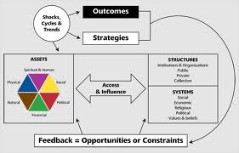
Broad view of Wealth and Well Being
Physical
Natural
Financial
Political
Social
Spiritual and Human

Slide 17
Good Wealth and Poverty
Development of Market and non-Market based wealth
Emphasis on human development
Education and Health
  Sick and Stupid is not a good anti-poverty program
Good Governance
  You need a government that is strong enough to fulfill its necessary functions, yet does not use that power for the benefit of an elite.
Public Investment
Balanced Wealth (especially financial wealth)
Wealth is always a means not an end.

