Slide 1
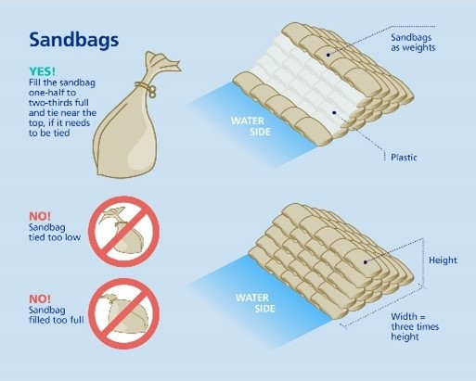
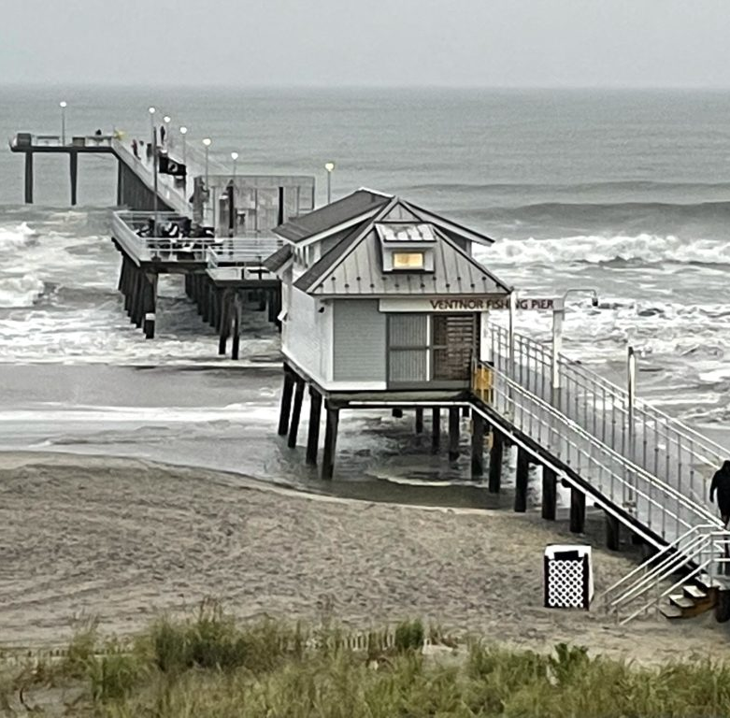
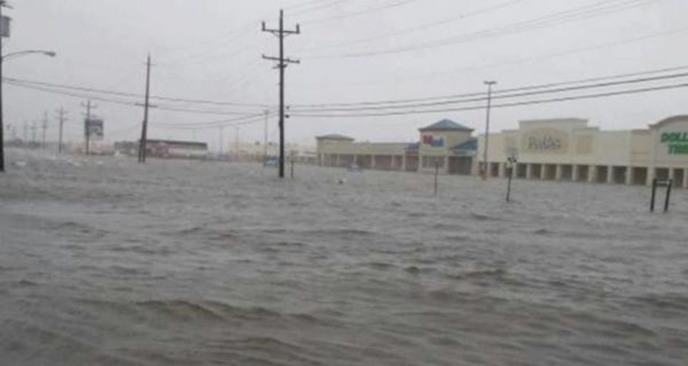
Save Our Town From Flooding
Beach Replenishment
What can we do?
According to the Army Corps of Engineers, the last “periodic nourishment was completed in February 2021,” and we are on a three-year nourishment interval, meaning that our next beach nourishment will be in 2023, pending funding for the project (US Army). These periodic nourishments of our beach is helpful in defense against flooding, but we need to do more! The replenished beach very well could be eroded again before our next replenishment. So, what can we do to better protect our town? In addition to the intermittent replenishment efforts of the Army Corps of Engineers, we need to continually carry out small-scale replenishment through nourishing our beaches from a stockpile of sand that we could store in the areas behind the boardwalk from S. Richards Ave. through S. Fredericksburg Ave.. We also need o build up our dunes and plant more vegetation in them.
Watch the video at the following link for more information: https://youtu.be/r7odasrgcJE
We all need to take steps to protect our businesses and homes, but what are those steps?
  Consider elevating your home.
  Install storm blinds to protect windows and other exposed glass on buildings.
  Be prepared with sandbags to use in the event of a serious storm and costal flooding. Inform yourself on how to properly employ sandbags!
  Consider purchasing and installing more solid but costly forms of flood prevention, such as the “Flood Log.”
Presented by Nickolas Naticchione,
Seton Hall University
Harsh winter storms are common along the shore and have caused varying issues for our island, including contributing to the erosion of the beaches, leaving our homes and businesses more exposed and prone to flooding. Please consult the information provided to learn more about what we need to do as a community to protect the homes and businesses of Ventnor.
Zurich . (2020). Proper and Efficacious Use of Sandbags. Zurich. Zurich Insurance Group. Retrieved December 14, 2021, from https://www.zurich.com/-/media/project/zurich/dotcom/industry-knowledge/flood-and-water-damage/images/173007141-sandbag-infographic.jpg?rev=325ee526e4cc499796e34f872d50ef46&amp;hash=09FB6940EEAEC90CCDAD9CAADEE03A6C.
Watson, S. (2014). Floods in Ventor Heights after Hurricane Sandy. Flood List. Flood List. Retrieved December 15, 2021, from https://floodlist.com/wp-content/uploads/2014/01/ventnor-heights-floods.jpg.
Sources
Support
US Army Corps of Engineers Philadelphia District &amp; Marine Design. (n.d.). Home. US Army Corps of Engineers Philadelphia District &amp; Marine Design Center Website. Retrieved December 15, 2021, from https://www.nap.usace.army.mil/Missions/Civil-Works/Coastal-Storm-Risk-Management/
The action that we need our town to take to prevent flood damage in the community will not be taken without your call for action! Reach out to the mayor and to county officials for support of measures described here and in my full report o prevent flooding from erosion of our beaches.
My Coast. (2021). Ventnor City Beach Nearly Covered During a Storm Surge at the Ventnor City Fishing Pier. My Coast. My Coast. Retrieved December 15, 2021, from https://report-images.nyc3.digitaloceanspaces.com/2021/08/21192639/e179bcc0ed3c1fc0c37d030894d767468297f2d2-1024x768.jpg.

