Slide 1
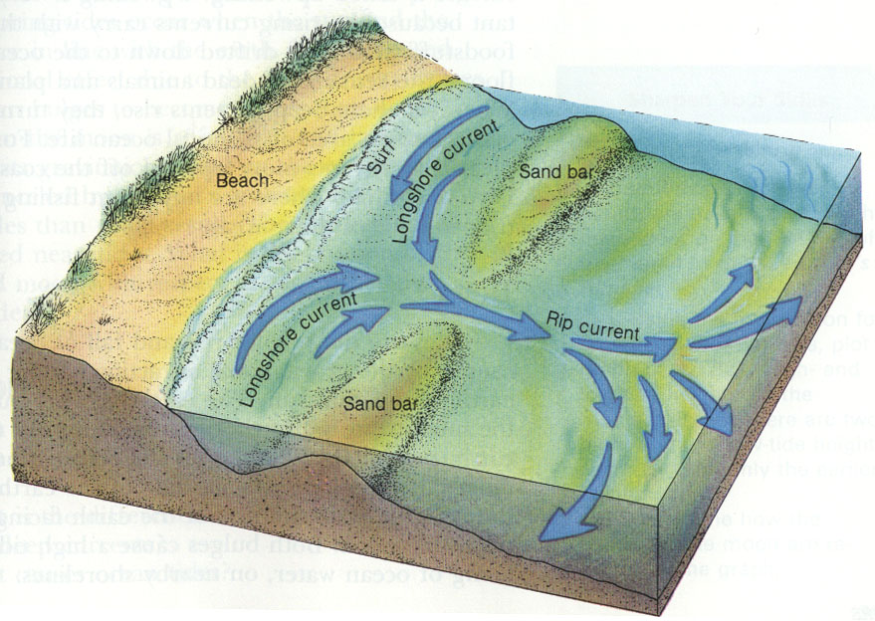
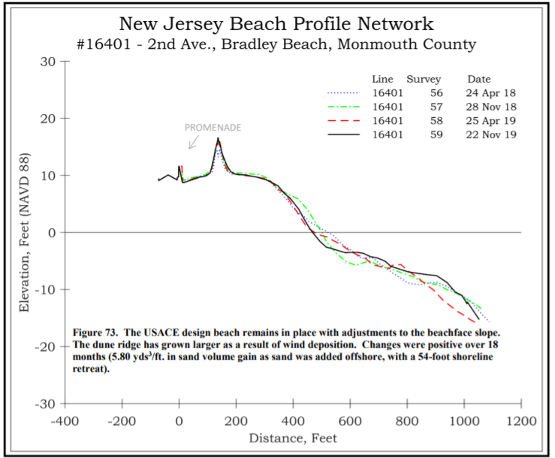
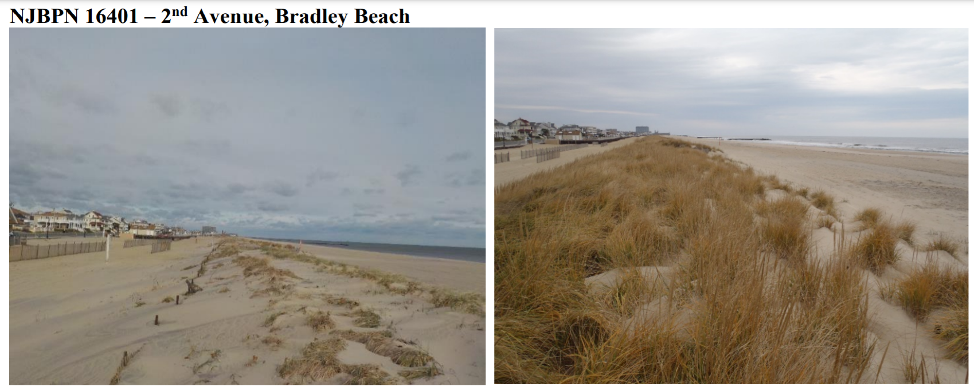
An Examination on Rip Current Induced Beach Erosion referencing Bradley Beach, NJ
Muhammed Z Mirza(mirzamuh@shu.edu)
Seton Hall University, South Orange, NJ 07079
Introduction- Beach erosion and its effects.
Beach Erosion is the gradual diminution of a beach through both natural and human based causes, leading to changes in the overall ecosystem and shoreline position. Erosion in this case is understood as removal of sand content from the beach and a few notable causes are rip currents, or winter storms. Beaches naturally remove and replenish sand content at varying rates leading to gradual changes, but recent environmental changes have altered rates which are affecting local ecosystems, water quality, and risking human safety.
Objective The objective is to examine rip current induced beach erosion at Bradley Beach, NJ, what effects it has caused and what solutions are either underway or possibility for implementation.
Causes: Rip Currents and More
Rip Currents are fast narrow seaward pushing currents that flow close to the shoreline. Because of their physical attributes they can easily capture and pull sand, small physical structures as well as biological organisms out to see. One of the causes for this is a break in the sand bar, and intensities vary based on wave energy. The sand they pull from the beach leaves rip embayment which make erosion more likely by larger waves. Figure 1 below gives a depiction of rip currents relation to the beach and sandbar.
Winter Storms are another cause of beach erosion, because the strong currents and fast wind remove a lot of the beaches sand.
Effects
Changing water Turbidity, and pH which in turn effects local biology
Openings for more aggressive currents which is a danger to people
Solution
Sand Replenishment: Dredging: when built up sand at the entrance of the Harbor is dug up and moved. This deepens the waterway allowing vessels to enter and exit.(Temporary solution that increase Rip current induced erosion)
Hard Methods: Jetties and Groins, initially allow sand build up by preventing outflux, depriving another area of the beach increasing erosion there.
Planting Vegetation: roots hold onto sediments and absorb water preventing erosion. (Long Term) This is depicted in Figure 2 at Bradley Beach
Figure 1 (NOAA, 2021)
Figure 3(Stockton university, 2020)
Figure 2 (Stockton university, 2020)
Conclusion:
Beach erosion is a natural occurrence and is bound to happen, we can mitigate but the forces of nature are more powerful. Figure 3 is an example of an overall positive change in sand level at Bradley Beach.

Slide 2
References
Bush, D. M., Pilkey, O. H., &amp; Neal, W. J. (2001). Coastal topography, human impact on. Encyclopedia of Ocean Sciences, 1, 581–590. https://doi.org/10.1016/b978-012374473-9.00078-3
Castagna, J. A. (2005). Features vol 49 no 3 - new jersey community pines for beach season. Retrieved December 16, 2021, from http://www.landandwater.com/features/vol49no3/vol49no3_1.html
Flammia, D. (2017, September 19). Deadly NJ rip currents - blame the beach replenishment projects? New Jersey 101.5. Retrieved December 16, 2021, from https://nj1015.com/deadly-nj-rip-currents-blame-the-beach-replenishment-projects/
Stockton University . (2020). New Jersey Beach Profile Network: Monmouth County. Beach Dune Performance Assessment . Retrieved December 16, 2021, from https://stockton.edu/coastal-research-center/njbpn/documents/reports/MonCo2019.pdf
Robinson, D. (2011, May 28). New Jersey state climatologist David Robinson says beach erosion 'under control' thanks to forgiving winter. CBS New York. Retrieved December 16, 2021, from https://newyork.cbslocal.com/2011/05/28/nj-beach-erosion-under-control-thanks-to-forgiving-winter/
Rip current safety. Rip Current Safety | Maine Emergency Management Agency. (n.d.). from https://www.maine.gov/mema/maine-prepares/preparedness-library/rip-current-safety.
US Department of Commerce, N. O. A. A. (2013, July 12). Rip current information. National Weather Service. from https://www.weather.gov/mhx/RipCurrentsInfo.
US Department of Commerce, N. O. A. A. (2021, July 13). How to avoid getting caught in a rip current. National Weather Service. from https://www.weather.gov/safety/ripcurrent.

