Slide 1
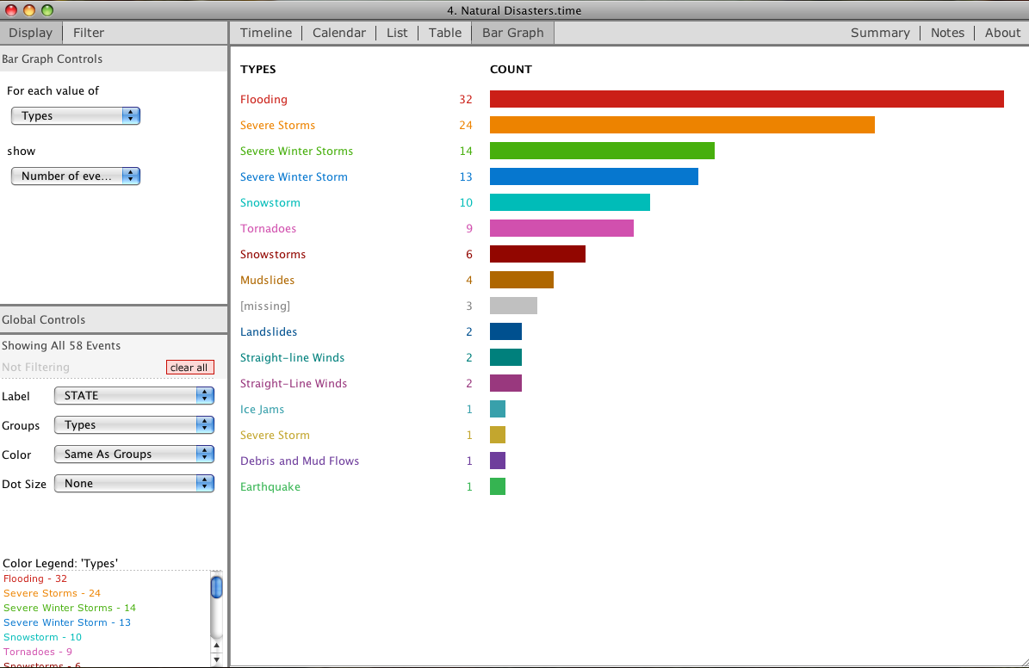
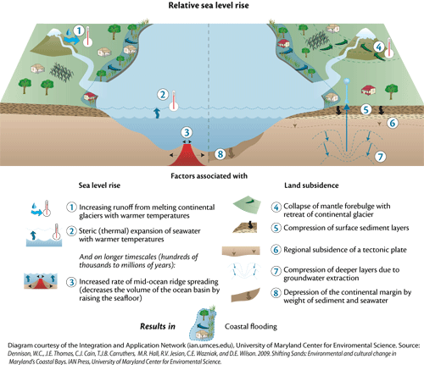
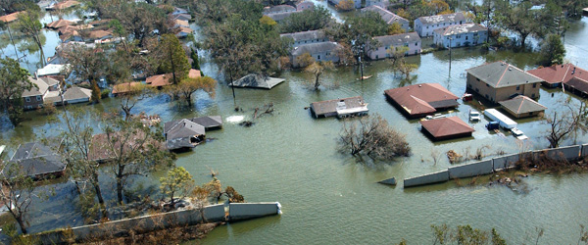
FLOOD SAFETY
Jeffrey Dattilo
Seton Hall University, South Orange, NJ 07079
Storms and Flooding:
During storms, floods are one of the most common disasters that towns suffer. The elements are at their worst if you live by the coast. Wind speeds can reach upwards of 65 miles per hour. Waves from the ocean can reach up to 16 feet high coming in every 4 seconds. The sand of the beach can recede 82 feet during these storms and vicious floods can ravage your town.
With sea levels rising every year, things could get worse.
What is a Flood?
A flood is the overflow of a stream channel that occurs when a discharge exceeds the capacity of a channel. This is the most common, yet destructive form of natural disaster (Essentials of Geology, 11th Edition)
Most floods are caused by atmospheric processes that can vary greatly in both time and space. An hour or less of intense thunderstorm rainfall can trigger floods in small valleys. However, floods can become large if there is a large amount of rainfall. Floods can become regional as the seasons change, or some floods can result as a failure of human technology, such as a dam failure. Some floods can get so bad that they become flash floods, which can be incredibly deadly.
Signs of an Impending Flood:
Floods are most likely to occur after a time of heavy rain fall
Floods often occur within 6 hours of heavy rainfall
Pay attention for National Weather Service Watches and Warnings:
Watches- indicates conditions make it likely for a flood to occur
Warning- indicates that flood is inevitable within the next hour
How to Prepare for a Flood:
Monitor your surroundings and pay attention to weather forecasts.
Stock up on Supplies- Bottled water, canned food, medicine, toiletries, batteries, flash light
Have a second, safe location to evacuate
Move valuable property to the highest point of your house
Have alternative travel routes and a car with a full tank of gas
Disconnect all electronics
Seal vents to basement
Tie down all lawn furniture you do not want to lose
Never drive through a flood covered roads
Fig. 2: http://ian.umces.edu/blog/wp-content/uploads/2012/01/iil_diagram_relative_sea_level_rise_shifting_sands3.png
Fig. 1:https://drawingbynumbers.org/sites/drawingbynumbers.org/files/Picture%2013.png
http://www.ready.gov/sites/default/files/Floods%201.1.1.0%20Tab%202%20of%204_1.jpg
Flood Prevention:
Elevate the furnace, water heater, air conditioner and other utilities.
Install "check valves" in sewer traps to prevent flood water back ups.
Construct interior barriers to stop low level floodwater from entering basements.
Seal walls in basements with waterproofing compounds to avoid seepage.
Consult http://dnr.wi.gov/emergency/flood.html
Remember: Floods can easily be deadly if the proper precautions are not taken
If there is heavy rainfall, pay close attention to weather forecasts
If floods are predicted, try and go somewhere safe or get to higher ground
Secure family, home, and possessions
Turn off electricity
Wait until it is safe to return
BE PREPARED- make a plan
Sources:
http://www.ready.gov/sites/default/files/Floods%201.1.1.0%20Tab%202%20of%204_1.jpg
http://ian.umces.edu/blog/wp-content/uploads/2012/01/iil_diagram_relative_sea_level_rise_shifting_sands3.png
https://drawingbynumbers.org/sites/drawingbynumbers.org/files/Picture%2013.png
http://www.susquehannafloodforecasting.org/before-during-after.html
Email Address: Jeffrey.dattilo@student.shu.edu

